Slide 1
SwasthRail: A Comprehensive Healthcare Platform for Indian Railway Hospitals
DSN4091- Capstone Project Phase-1 Review 2
Supervisor: Dr.Azra Nazir
Group- 26

Slide 2
Team
Aman Rathour
21BCE11284
Suniksha Ben Patel
21BCE10497
Marwa Asad
21BCE10027
Sunandini Chakrabarty
21BCE10442
B Eesha Pranav
21BCE11680
01

Slide 3
Objective
The objective of SwasthRail is to develop a comprehensive healthcare platform tailored for Indian railway hospitals, aiming to improve the quality and accessibility of healthcare services for railway employees and their families. The platform integrates AI/ML, IoT, and web technologies to offer features like appointment booking, telemedicine services, emergency response systems, room availability management, and collaboration with private hospitals for specialized treatments. Additionally, it promotes employee wellness through yoga sessions, stress management tips, and personalized health recommendations, fostering a healthier and more efficient railway workforce.
02

Slide 4
Clarity of problem statement
Railway employees, particularly those stationed in remote locations, often face challenges in accessing timely and specialized healthcare. Indian railway hospitals, though widespread, lack a unified system to efficiently manage patient appointments, emergencies, and specialized treatments.
This leads to delays in care, difficulty in accessing telemedicine services, and inefficiencies in hospital resource management. Furthermore, the absence of personalized wellness programs reduces the focus on preventive healthcare.
SwasthRail addresses these challenges by providing an integrated digital healthcare platform. By combining AI/ML, IoT, and web-based technologies, it enables efficient hospital operations, improves patient-doctor interactions, and enhances access to remote healthcare services.
Additionally, it promotes employee well-being through wellness content, helping railway staff stay healthy and stress-free. This makes the platform critical for enhancing healthcare outcomes and operational efficiency in the railway sector.
03

Slide 5
Feasibility of the project
The SwasthRail project is technically feasible due to the availability of modern web development frameworks, AI/ML tools, and IoT devices, which can be effectively integrated to create a robust healthcare platform.
Frontend Technologies- HTML, CSS, JavaScript
Backend Technologies- PHP, Flask
Database- MySQL
Chatbot- Python
Data Analytics - Power BI
The availability of cloud platforms like AWS, Azure, or GCP makes it feasible to deploy and manage the application, ensuring data security, performance, and scalability. The project is also feasible within the given timeframe as the modular architecture allows development teams to work on different components (telemedicine, emergency response, room booking, etc.) in parallel.
04

Slide 6
Scope of the project
Appointment Booking: A system for booking doctor appointments based on availability.
Emergency Response: A real-time notification system for emergencies.
Telemedicine: Remote consultations for employees stationed in remote areas.
Room Management: Managing room availability and booking for inpatient care.
Collaboration with Private Hospitals: Referral system for specialized treatments.
Health Monitoring via IoT: Integration of wearable devices for real-time health data monitoring.
Wellness Programs: Streaming yoga sessions, stress management tips, and fitness content to promote employee well-being.
AI-Driven Health Recommendations: Personalized diet and health advice based on the user's medical history and current health metrics.
05

Slide 7
Existing Projects
eSanjeevani (Government of India)
Overview: eSanjeevani is a national telemedicine service offering remote consultations, specifically aimed at citizens across India.
Similarities: Offers telemedicine services, enabling remote consultations between doctors and patients.
Differences: SwasthRail is designed specifically for railway employees and includes additional hospital management features such as room bookings, emergency response systems, and collaborations with private hospitals. It focuses on the unique needs of railway staff in remote and field locations, incorporating IoT devices for health monitoring and emergency notifications, which eSanjeevani lacks.
06

Slide 8
Existing Projects
2. Practo
Overview: Practo is a private healthcare app that offers appointment booking, telemedicine, and pharmacy services.
Similarities: Provides appointment scheduling and telemedicine services, along with access to medical records.
Differences: Practo is a general multi-specialty platform, while SwasthRail is tailored to the Indian railway ecosystem. Practo lacks emergency response and IoT remote monitoring, whereas SwasthRail integrates with private hospitals for specialized railway patient referrals, offering a focused healthcare network.
3. Aarogya Setu
Overview: Aarogya Setu is a COVID-19 contact tracing and health monitoring app launched by the Government of India.
Similarities: It uses mobile technology to monitor health and send notifications.
Differences: Aarogya Setu focuses solely on pandemic monitoring and contact tracing, while SwasthRail addresses a wider range of healthcare needs, including routine checkups, specialized treatments, and stress management.
07

Slide 9
Timeline
Phase 1: Initial Development
Duration: Month 1 - Month 4
Key Deliverables by First Review:
Patient Portal: Major features completed (appointment booking, patient records, telemedicine integration).
Doctor Portal: Basic setup done (doctor profiles, login functionality, initial patient record access).
Home Page: Functional, includes navigation to all core areas (Patient Portal, Doctor Portal, Hospital Info, etc.).
Chatbot: Core framework developed, with initial training to handle basic queries.
08

Slide 10
Timeline
Phase 2: Expansion, Duration: Month 5 - Month 8
Key Focus:
Doctor Portal: Full implementation, including all functionalities such as managing patients, prescriptions, and analytics.
Room Availability Management: Integrate IoT to track and update room status in real-time.
Emergency Response System: Start the development of an emergency alert system for railway employees and families.
Phase 3: Final Development, Duration: Month 5 - Month 8
Full System Integration: Ensure all parts of the platform, including AI-driven health recommendations, room management, and wellness features, work seamlessly together.
Final Documentation and Training: Prepare user manuals and documentation.
09

Slide 11

Literature Review
AI and ML in Healthcare
AI and ML are reshaping healthcare by improving diagnostics, streamlining operations, and enabling personalized treatments. AI applications, as noted by Topol (2019), are crucial in predicting patient needs and optimizing hospital workflows. In SwasthRail, AI powers appointment scheduling, telemedicine, and personalized health recommendations.
IoT in Healthcare
IoT devices enable real-time monitoring and efficient resource management in hospitals. Studies show IoT’s potential to track patient vitals and manage bed availability, making it essential for SwasthRail’s room management and emergency response systems.
Chatbots in Healthcare
Chatbots enhance patient interaction by handling routine queries and facilitating appointment booking. Research highlights their efficiency in reducing staff workload and providing 24/7 support.
10

Slide 12

Project Modules
User Management Module: To handle user registration, authentication, and role-based access for patients, doctors, and hospital staff.
Components:
User Registration
Login/Logout
Role Management (Admin, Doctor, Patient)
Associations: Interacts with all other modules to ensure secure access based on user roles.
Appointment Booking Module: To facilitate appointment scheduling for patients to consult doctors.
Components:
Slot Booking System
Emergency Response Notifications
Associations: Connects with User Management and Telemedicine modules for seamless appointment management.
11

Slide 13
Project Modules
Telemedicine Module: To enable remote consultations for patients, especially those in remote areas.
Components:
Video Conferencing
Chat Functionality
Prescription Management
Associations: Works closely with User Management and Appointment Booking for consultation management.
Patient Management System: To manage patient records, history, and treatment plans.
Components:
Medical History Storage
Test Results Management
Treatment Plan Documentation
Associations: Integrates with User Management and Appointment Booking for personalized patient care.
12

Slide 14
Project Modules
Room Booking System: To allocate hospital rooms based on availability and patient needs.
Components:
Room Availability Tracking
Booking Management
Associations: Ties into Patient Management to determine room allocation for admitted patients.
Collaboration with Private Hospitals: To facilitate referrals and partnerships with local private hospitals for specialized treatments.
Components:
Referral System
Treatment Coordination
Associations: Links with Patient Management to ensure seamless transitions for patients needing specialized care.
13

Slide 15
Project Modules
Health and Wellness Module: To provide resources for preventive health and wellness.
Components:
Yoga and Fitness Sessions
Diet and Nutrition Plans
Health Awareness Programs
Associations: Promotes overall well-being, connecting with all user types to encourage healthy practices.
Analytics and Reporting Module: To generate insights and reports for improving hospital operations and patient care.
Components:
Patient Statistics
Operational Efficiency Reports
Associations: Analyzes data from all modules to provide a holistic view of hospital performance.
14

Slide 16

Screenshots and Videos

Slide 17
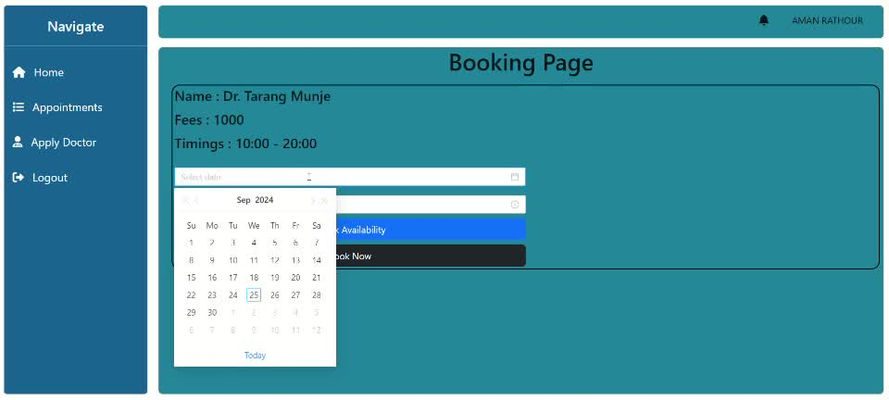

Slide 18
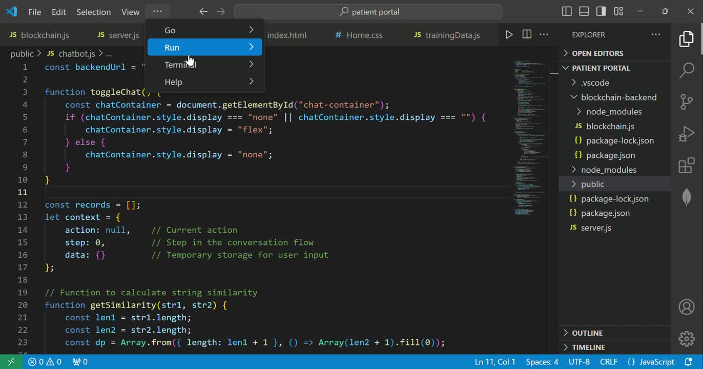

Slide 19

References
Journal Articles:
Joshi, A., & Singh, R. (2023). The Role of Machine Learning in Enhancing Telemedicine Services. *International Journal of Medical Informatics*, 168, 104-112.
Mehta, P., & Kumar, S. (2023). IoT-Based Health Monitoring Systems: A Comprehensive Review. *Journal of Healthcare Engineering*, 2023, 1-15.
Conference Papers:
Sharma, N. (2023). Emergency Response Systems in Healthcare: A Case Study of Railway Hospitals. In *Proceedings of the International Conference on Health Informatics* (pp. 101-108).
Websites:
National Health Service. (2022). The Future of Telehealth: Innovations and Trends. NHS.
World Health Organization. (2023). Digital Health: A Global Strategy for Implementation. WHO.
Theses and Dissertations:
Verma, R. (2022). AI-Driven Solutions for Remote Patient Management (Unpublished master’s thesis).
15

Slide 20

Thank You
reallygreatsite.com

